Slide 1

Save the Programmer.
Save the Planet.
Mike Mathieu
Front Seat
3/11/09

Slide 2


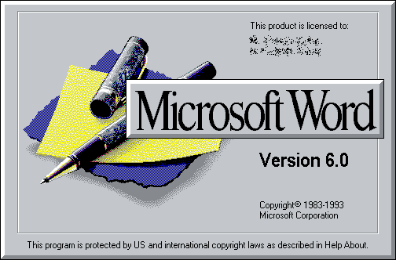

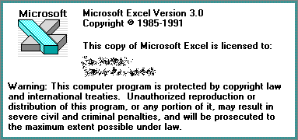


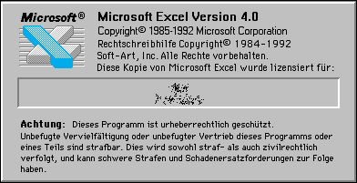

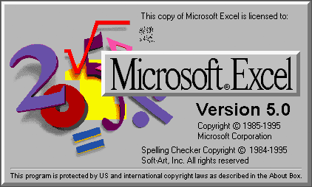
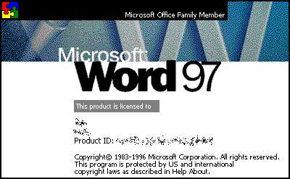
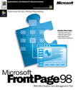
About Me

Slide 3


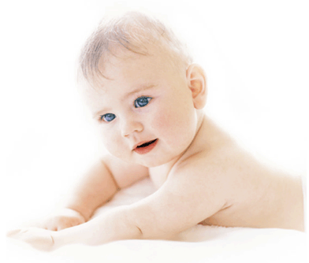
About Me

Slide 4







About Me

Slide 5


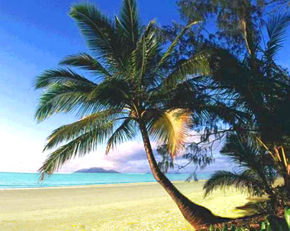
About Me

Slide 6
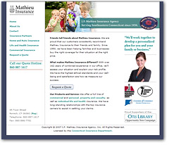
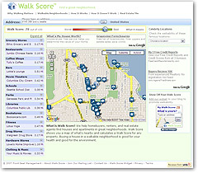
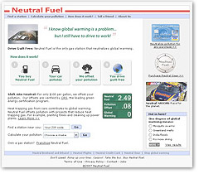
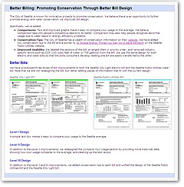
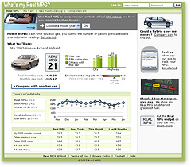
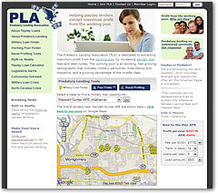

Slide 7
Civic Software

Slide 8
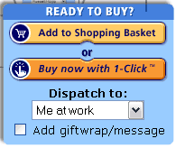
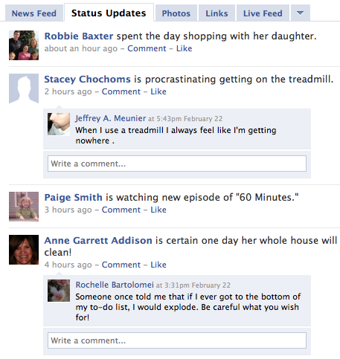




Software
Empowering
Creative Destruction
Change
Notes:
Empowering me to shop in my underwear
Competing with the Somalian’s at the Pirate of the Year awards
And watching the change in my social graph, rather than making change happen

Slide 9
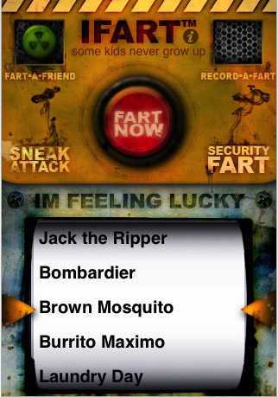
Notes:
“The world’s most popular digital fart machine!”
Complete 8.9MB download for just $0.99

Slide 10



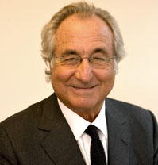










Crisis

Slide 11
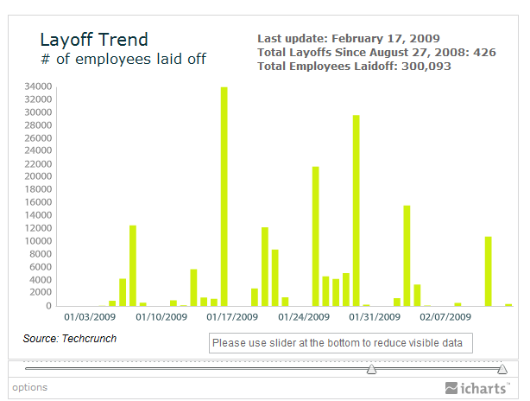
Tech Layoffs

Slide 12
Hope

Slide 13
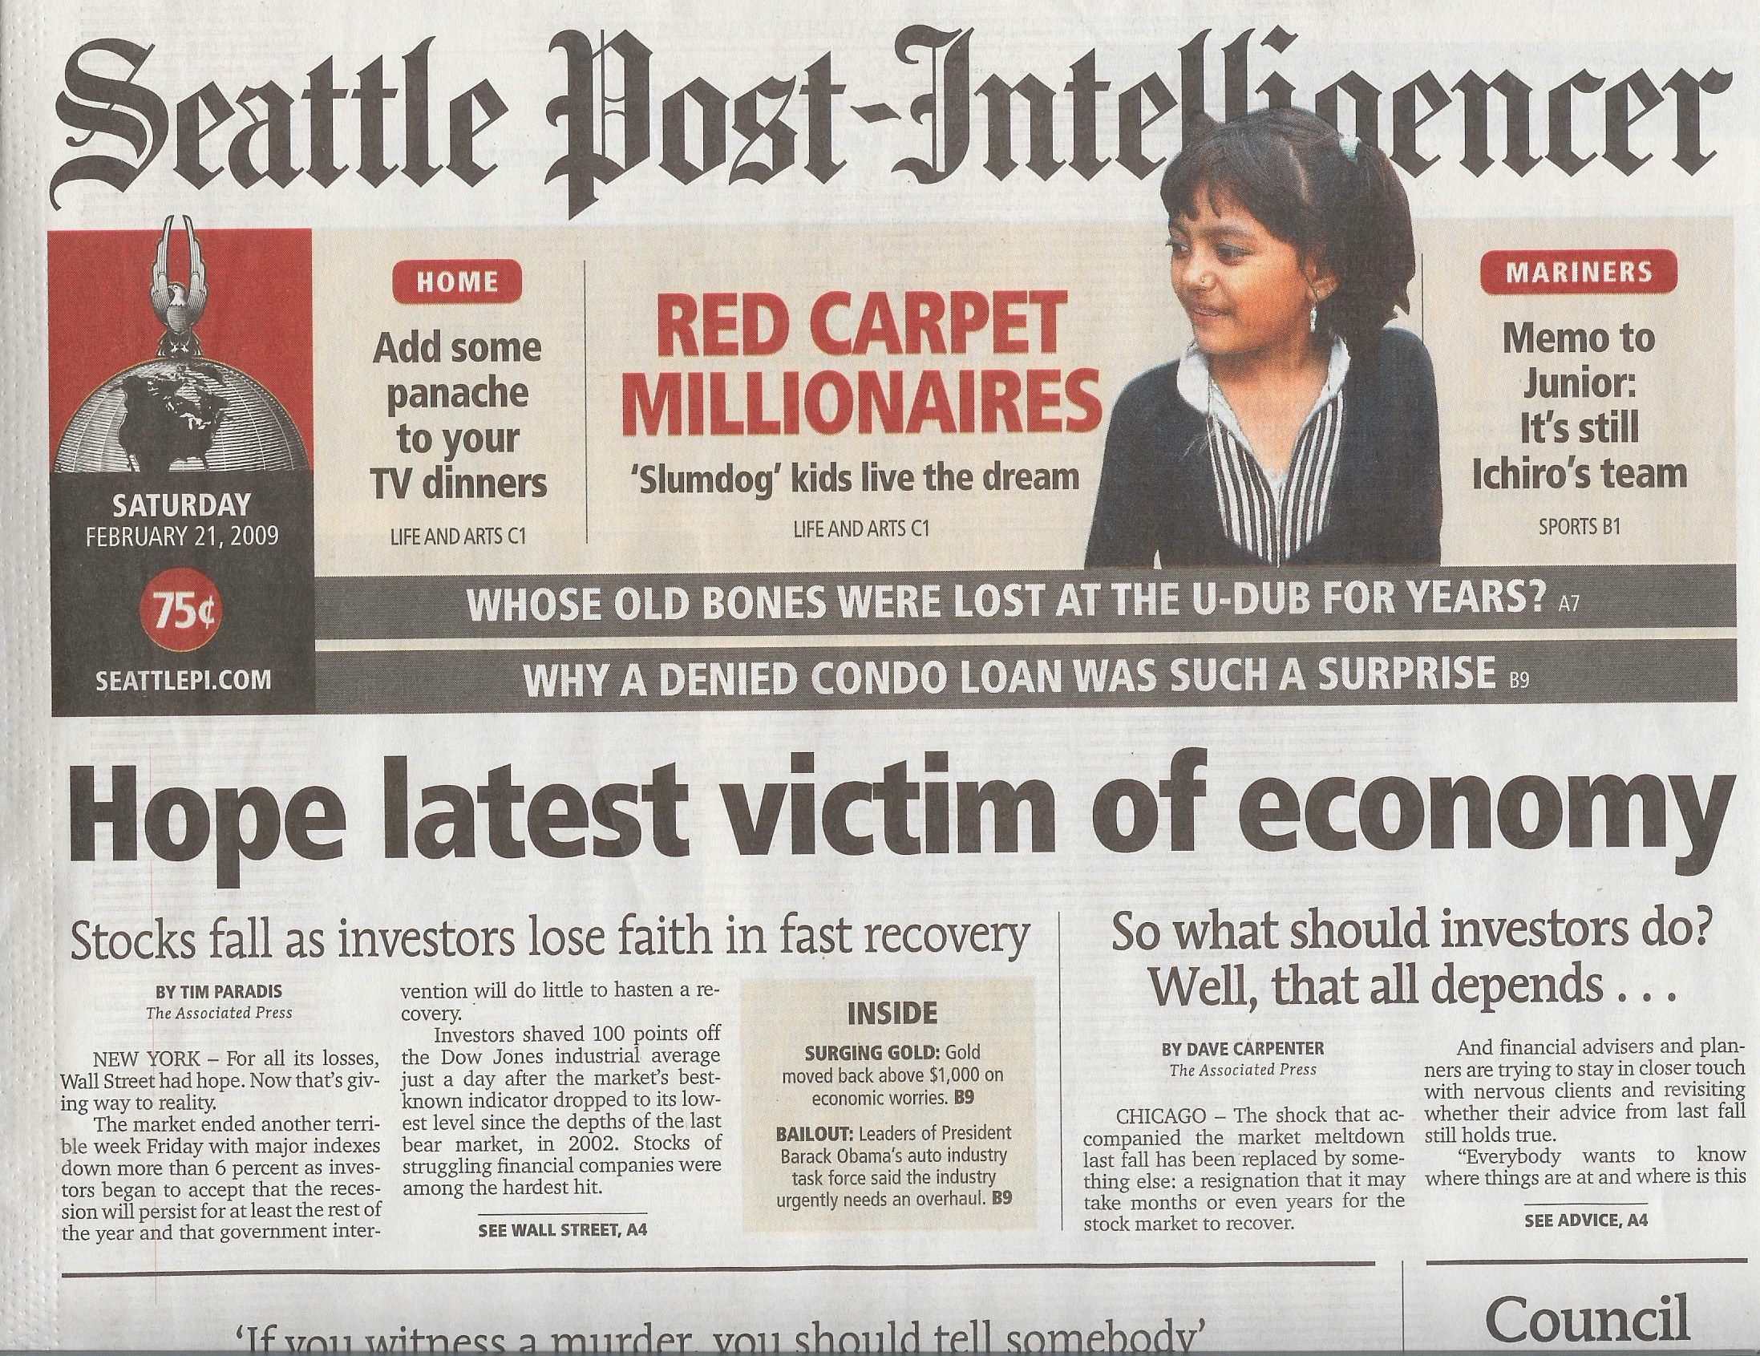

Slide 14
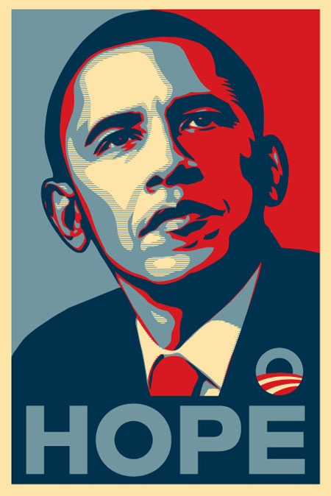

Slide 15
Economics
2 Fixed Costs
1 Variable Costs

Slide 16
Cheap Software
Notes:
Like barn raising of old, we now have people getting together for a weekend and building apps.

Slide 17
Cheap Software Opportunity
Data becoming more important than code
  Google, Amazon, Craigslist, Twitter
Civic Data is plentiful and largely untapped
2 people in a room can do something useful
Notes:
Software speaks louder than words

Slide 18
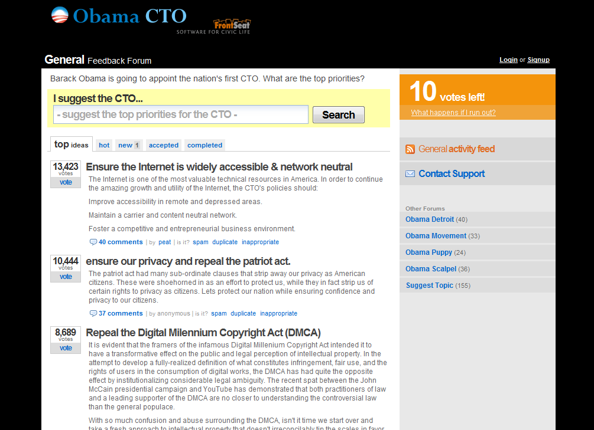

Slide 19
Demos
FixMyStreet.com (MySociety)
CountMore.org
Walk Score
Transit Time

Slide 20
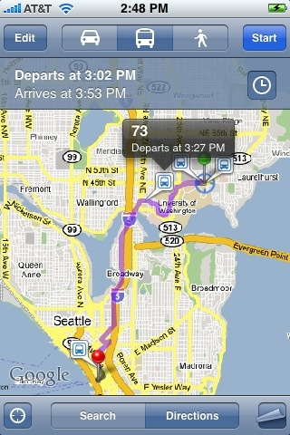
Google Transit on iPhone

Slide 21
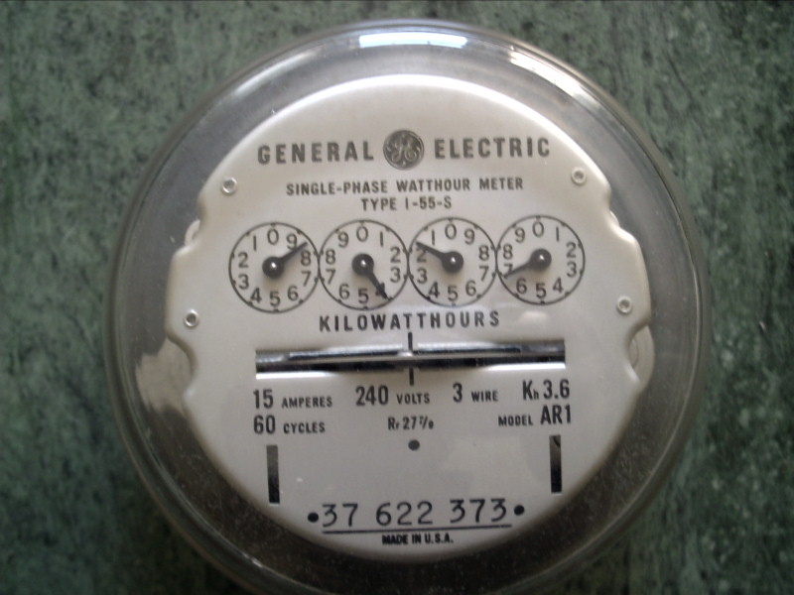
Visualization

Slide 22
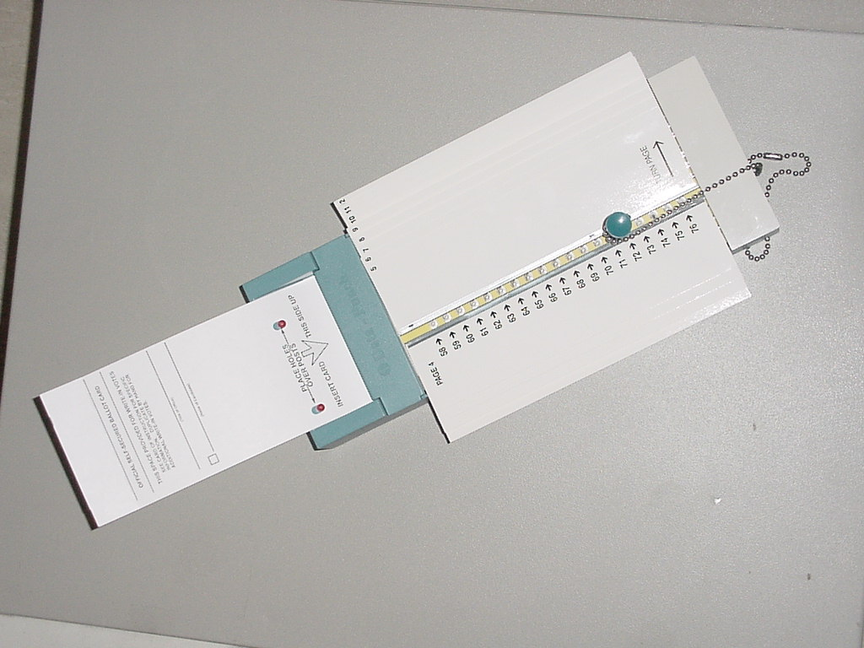
Usability

Slide 23
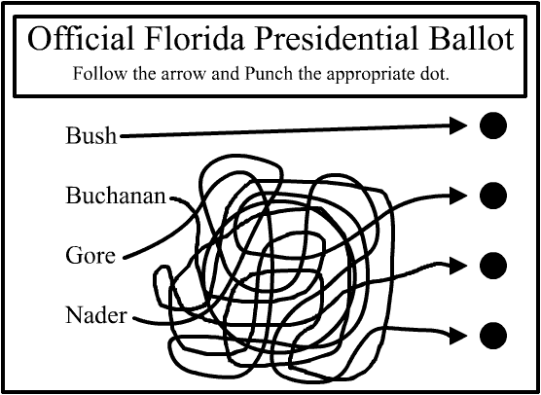
Notes:
StarTribune – The Ballot Challenge – crowdsourcing the recount

Slide 24
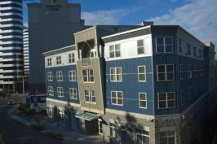
Civic Intelligence

Slide 25
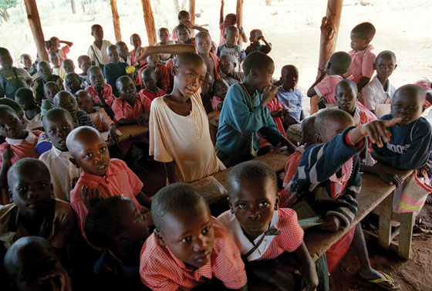
Transparency

Slide 26
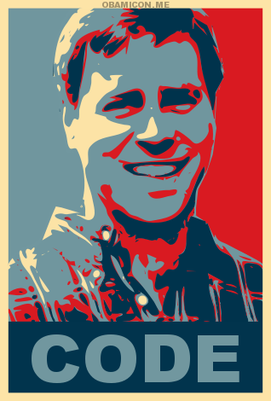
Hope
Notes:
Cheap software + government data + community
Pick your issue
Don’t put a good crisis to waste

